Slide 1
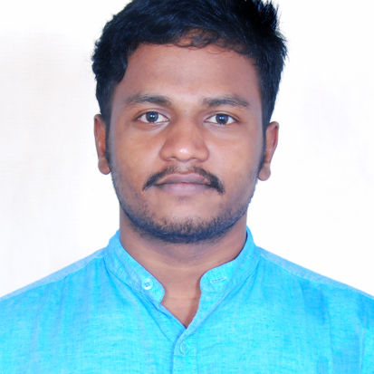

VANNE GUNASEKHAR
Analyst/Software Engineer
Bachelor of Technology
Mechanical Engineering: 2018 - 2021
Skills C#
Python
Database
SQL database – Oracle SQL
Microsoft SQL
Web Technologies
HTML
Web API
CSS
Bootstrap
Add-ons
GitHub
Postman
Additional Details
Leadership
Good Listener
Team management
Quick Learner
Bangalore
Vanne.gunasekhar@capgemini.com
+91 6309780797
A4
Software Engineer who. Self-motivated and hardworking fresher seeking for an opportunity to work in a challenging environment to prove my skills and utilize my knowledge & intelligence in the growth of the organization.
Eager to work in a team of dedicated people and serve a key role in the enhancement and development of the project.
Has working knowledge of C#, SQL Server and Oracle SQL
EMPLOYEE MANAGEMENT SYSTEM
Completed end to end case study of Employee Management System, Postman and swagger Testing Html CSS used for user interface.
Az-900 Certification from Microsoft
Completed the course with 865/1000

